Slide 1
Managing Human Capital in Retail
Introduction
Matthew Bidwell, Associate Professor of Management

Slide 2


Trader Joe’s
On top in customer satisfaction in 2019-20 (American Customer Satisfaction Index)
Highest sales per square foot
Consistent growth over 50 years (6% CAGR over last decade)

Slide 3
Managing Human Capital in Retail
Course Overview
Matthew Bidwell, Associate Professor of Management

Slide 4
Course Overview
Module 1: Human Capital and Perfomance
Human capital as cost driver vs. value creation
From headcount to organizational capacity
The Ability-Motivation-Opportunities framework
Human capital management as a system

Slide 5
Course Overview
Module 2: High Performance Staffing
The value of hiring right
Best practices in selection
Building an effective talent pipeline

Slide 6
Course Overview
Module 3: Development and Retention
Costs and benefits of training
How development works
Understanding attrition
Strategies for retention

Slide 7
Course Overview
Module 4: Motivating the Frontline Workforce
Understanding motivation
Setting compensation
Motivation through job design

Slide 8
Managing Human Capital in Retail
Human Capital as Cost Driver vs. Organizational Capacity
Matthew Bidwell, Associate Professor of Management

Slide 9
Human Capital as Cost Driver vs. Value Creation
Human Capital as Cost Driver
Wages and benefits major component of costs
Profits = Sales - Costs
Increase profits by:
Minimizing levels of wages and benefits
Minimizing overall staffing levels (e.g. matching supply and demand in scheduling)

Slide 10
Human Capital as Cost Driver vs. Organizational Capacity
Human Capital as Organizational Capacity
People determine what gets done
Value delivered to customers
Overall cost structure
Capacity reflects:
Headcount
Skills
Engagement

Slide 11
Managing Human Capital in Retail
From Headcount to Organizational Capacity
Matthew Bidwell, Associate Professor of Management

Slide 12
Taylorism and Scientific Management
The Approach
“One best way” of carrying out each task
Thinking (brains) and doing (hands) performed by different groups of workers
Frontline employees follow carefully designed processes
Organizational capacity = headcount + processes

Slide 13
Taylorism and Scientific Management
Advantages
Challenges
Promise of efficiency
Creates consistency
Deskilling
Allows hiring of lower paid workers
Allows more rapid integration of new hires
Maintaining compliance/ disengagement
Dealing with exceptions
Lack of learning/innovation

Slide 14
The Partnership Approach
The Approach
Employee empowerment
Frontline employees involved in designing and improving processes
Frontline employees given discretion to handle exceptions
No separation between thinking and doing
Effort to align employees with organizational goals
Organizational capacity = employee skills + employee engagement

Slide 15
The Partnership Approach
Advantages
Challenges
Increased commitment and enthusiasm by workforces
Increased flexibility
Bottom up innovation and adaptation
Greater reliance on frontline workforce to deliver your strategy
Substantial investments in workforce capabilities

Slide 16
Managing Human Capital in Retail
The Ability-Motivation-Opportunities Framework
Matthew Bidwell, Associate Professor of Management

Slide 17
Understanding Individual Performance
Abilities
Innate talents
Developed skills
Acquired knowledge
Motivation
Opportunities
Willingness to exert effort
Alignment with organizational goals
Environment
Supporting organizational structures and processes
Extent of discretion

Slide 18
How HR Practices Support Organizational Performance
Abilities
Selective Hiring
Effective Development
Motivation
Opportunities to Participate
Generous pay and benefits
Pay for Performance
Long term opportunities
Purpose and values
Self-managing teams
Suggestion systems
Process design

Slide 19
Managing Human Capital in Retail
Human Capital Management as a System
Matthew Bidwell, Associate Professor of Management

Slide 20
HR Practices as Complements
Abilities
Selective Hiring
Effective Development
Motivation
Opportunities to Participate
Generous pay and benefits
Pay for performance
Long term opportunities
Purpose and Values
Self-managing teams
Suggestion systems
Process design

Slide 21
Managing Human Capital in Retail
The Value of the Partnership Approach
Matthew Bidwell, Associate Professor of Management

Slide 22
Evidence for Success of the Partnership Approach
Exemplars
Trader Joe’s
Wegmans
Costco
Southwest Airlines
Nucor

Slide 23
Evidence for Success of the Partnership Approach
Studies
Automotive
Steel finishing
Garments
Medical equipment
Fortune 500
Retail banking
Retail in Finland

Slide 24
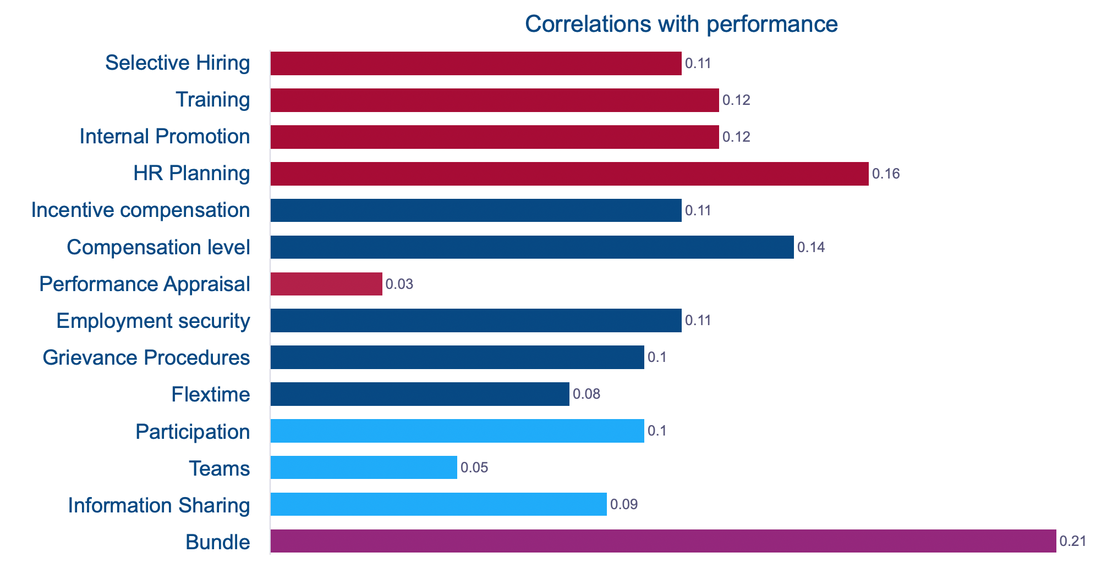
What Works at Work?
Meta-analysis of 92 different studies
Multiple measures of performance include productivity, profits and sales

Slide 25
Managing Human Capital in Retail
Human Capital Management Strategy
Matthew Bidwell, Associate Professor of Management

Slide 26
Understanding Strategy - Cost to Serve vs. Willingness to Pay
Cost to Serve
Customer Willingness to Pay
Your costs of providing the goods
Quality
Differentiation over competitors
minimum price
maximum price
maximum profit

Slide 27
Fine Tuning the Details
Abilities
Selective Hiring
Effective Development
Motivation
Opportunities to Participate
Generous pay and benefits
Pay for performance
Long term opportunities
Purpose and Values
Self-managing teams
Suggestion systems
Process design

Slide 28
Summary
Organizational performance depends on your organizational capacity
Headcount, processes, skills, engagement
A partnership model emphasizes the frontline workforce as full partners in designing, implementing, and innovating your services
Effective partnership requires careful attention to:
High levels of workforce skills
Aligning employee and organizational goals
Creating opportunities for employees to participate in decision-making
Substantial evidence that the partnership approach yields benefits across industries and strategies

Slide 29


